Slide 1
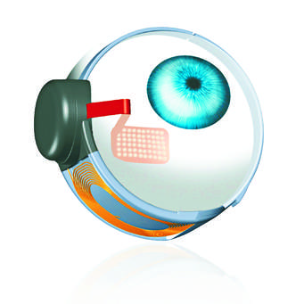
ARGUS II
ARGUS II
M.MEHRYAR SHIRAZ IRAN

Slide 2
Argus II
IS USED in blind patients with RP
to induce visual perception
By electrical stimulation of the retina

Slide 3
Patient selection
1-Adults, age >18-25 years or older
2-Bare LP or NLP in both eyes
3-Previous history of useful form vision
4-Aphakic or pseudophakic.

Slide 4
Patient selection continued
…
5-Patients who are willing and able to
receive the recommended post-implant
follow-up
device fitting, and
visual rehabilitation

Slide 5
The Argus II
should be implanted in a ONE eye only
typically the
worse-seeing eye

Slide 6
Complete ophthalmic examination nedded including
• Pupil Examination
• Intra - ocular Pressure
• Extra - ocular Motility (presence of strabismus)
Indirect Ophthalmoscopy

Slide 7
Patient screening
Perform visual function tests
COLOUR Fundus PHOTO
OCT
Ultrasound A scan and B scan

Slide 8
Imaging – Clinical Considerations

Slide 9
Exclusion criteria
1-Ocular diseases damaging the inner retina (CRAO,CRVO,Advanced DM,Optic nerve disease,TRAUMA,Hx of RD op glaucoma shunt..)
2-Conditions affecting visualisation of the retina like corneal opacity
3-Conditions that predispose to eye rubbing

Slide 10
Exclusion criteria…
4-Axial length < 20,5-or 21.5mm and > 26 mm
5-Inability to understand the experiment or consent
6-Can not undergo general anesthsia or tolerate post op medications
8-Another implantable device ( cochlear implant)

Slide 11
Residual light sensitivity
In theory, retinas with better light detection at baseline
should have lower electrical stimulation thresholds

Slide 12
THANK YOU

