Slide 1
Plexr plus
Indication for treatment
By plexr

Slide 2
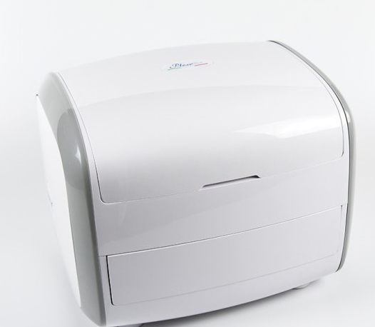

Slide 3
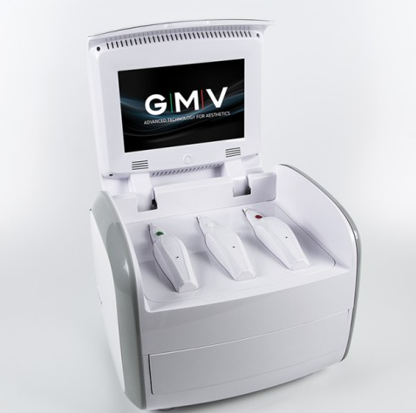

Slide 4
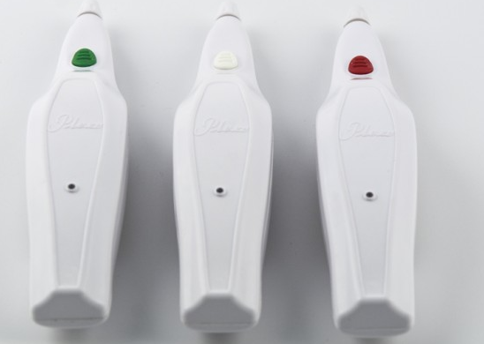

Slide 5
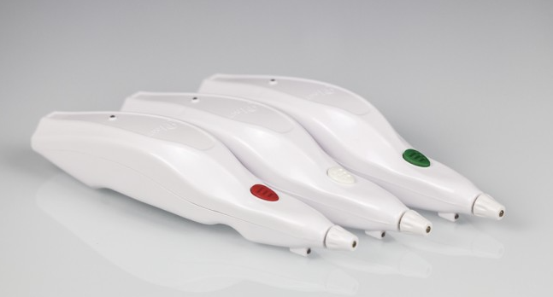

Slide 6
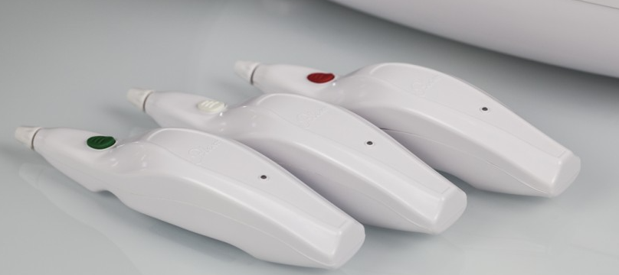

Slide 7
Plexr is currently available in 3 different power levels
used to efficiently treat different imperfections.

Slide 8
Low power Plexr (white)
Blepharoplasty
Ring Block Anaesthesia
Skin spots
Small soft warts
Active acne
Wrinkles
Peri-umbilical stretch marks
Xantelasmas
Small neoformations max 2cm3 –
Tattoos.

Slide 9
Medium power Plexr (green)
Active acne
Wrinkles
medium neoformations
small keloids
Small cherry angiomas
face lifts
Significant xantelasmas with thickness.

Slide 10
High power Plexr (Red)
Large moles
Keloids
Medium/large cherry angiomas
Seborrhoeic warts
Large fibromas.

Slide 11
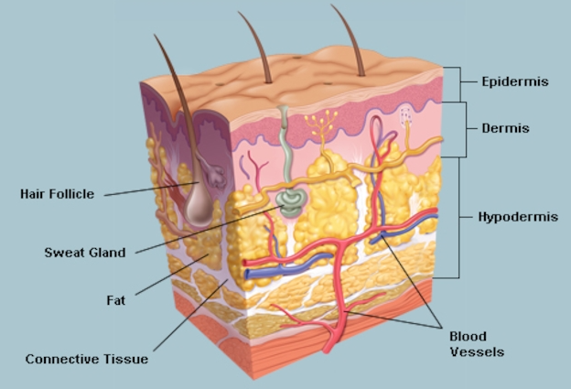
SKIN LAYERS

Slide 12
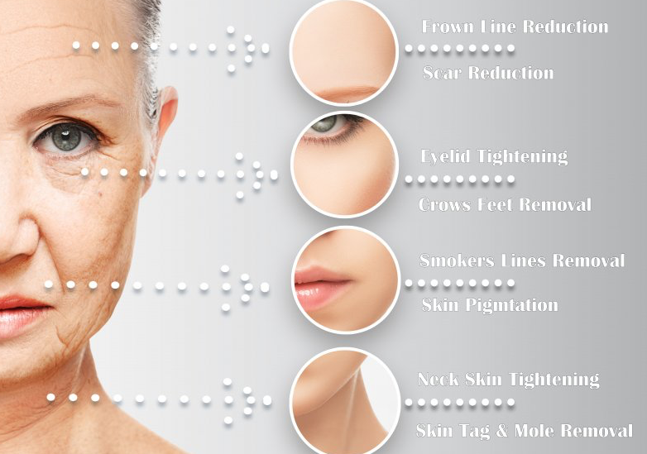
CORECTION AREAS

Slide 13
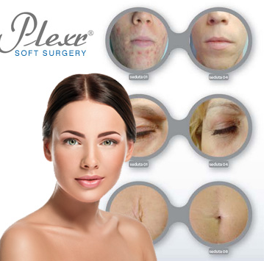
CORECTION AREAS

Slide 14
Fields can be worked with plexr
^{DERMATOLOGY}
^{AESTHETIC MEDICINE}
^{PLASTIC SURGERY}
^{OCULOPLASTY}
^{GINECOLOGY}
^{DENTISTRY}

Slide 15
Treatment options
^{Non Surgical Eyelid Ptosis}
^{Stretch Marks}
^{Hyper pigmentation Keloids}
^{Ruby Angioma Xanthelasmas}
Coloured Tattoos )any colour( Face, Neckline and Body Lifting Spot
Vulvoplasty Ectropion and Entropion
Seborrheic Cysts Hemangiomas Vaginal Rejuvination
Scars Moles Gingivectomy Herpes Simplex ,fibroma
warts

Slide 16
mode s of treatment
spot mode = each point’s wrist around which the tissue twist
Spray mode = sublimation

Slide 17
Micro-plasma generator
Constant pseudosinusoidalni signal
Operating frequency 70kHz ± 25
3 manual continuing for three different types of myco-plasma
volume 3 (0.7W ,1W, , 2W) to carry out all treatments in noninvasive surgery

Slide 18
DVANTAGES:
Certainty
Precision
Adaptability
Easy to handle
Portable
Different strengths: 3 manual continuation
No consumables

Slide 19
The device advantages
- Monitoring of use/activity time (password-protected).
- The handset can also be activated via a pedal.
- Innovative wireless induction recharging system.
- Automatic connection of handsets to base.
- Monitoring of user time for individual handsets (with reset function).
- SCT (self-check test) function with warning signal.
- Lithium polymer batteries can be removed and exchanged.
- Wireless connection between handset and base.
- Different frequency and power transmission levels in the three handsets.
- Touchscreen for settings, viewing video and monitoring battery levels.
- Water resistant.
- Automatic and selective unit cooling system.

Slide 20
indication for plexr Rx
Pigmentation
sun spot
Xanthlasma
keloid
Steria
Nivea
Wrinkle and permanent expression line
tattoo removal
white spot
Hemangioma
Enteropion
Ectropion
Labioplasty
Fibroma
Wart
Papilloma
Active acne
Acne scar
Post surgical scar
Mole Rx
Gingivectomy

Slide 21
indication for plexr Rx …
Saggy excess upper eye lid skin
Baggy lower eye lid skin
Collection of tissue
Removal of benign growths: fibroids, moles, warts, keloids, brown / white spots
benign skin neoplasm in oral cavity
- Face and body lift
- Omphalo lifting
Crows feet and wrinkle
Small skin leisions
Lines and wrinkle
Periumbilical and genital rejuvenation
Removing the discoloration of the skin (hyper and hypopigmentation)
- Correction of post-acne and other scars

Slide 22
INDICATIONS
Periorbital rejuvenation
Non Surgical Blepharoplasty
Perioral rejuvenation
Rejuvenation of neck and face
Removal of warts

Slide 23
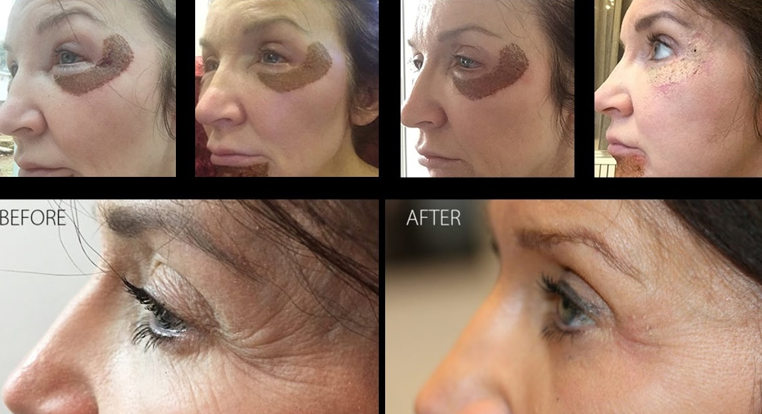
Crows feet

Slide 24
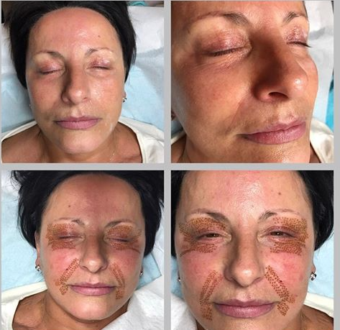
Wrinkle and fold

Slide 25
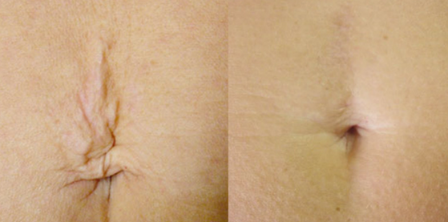
Scar and wrinkling around umblicus

Slide 26
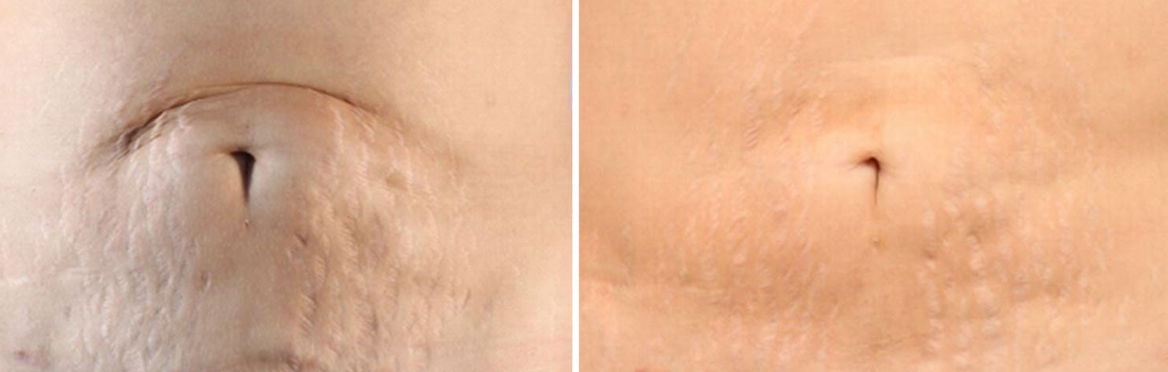
Scar and wrinkling around umblicus

Slide 27
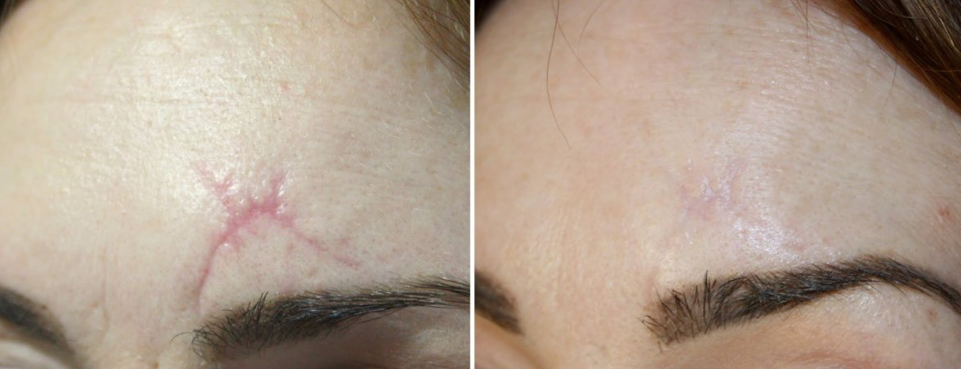
scar

Slide 28
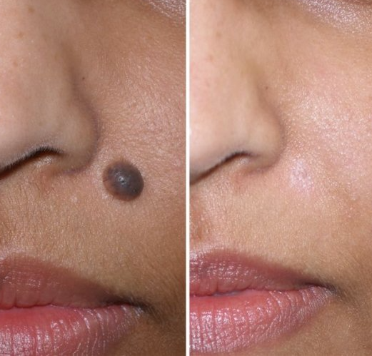
Nevus

Slide 29
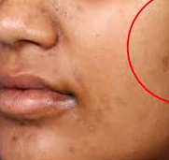
nevus

Slide 30

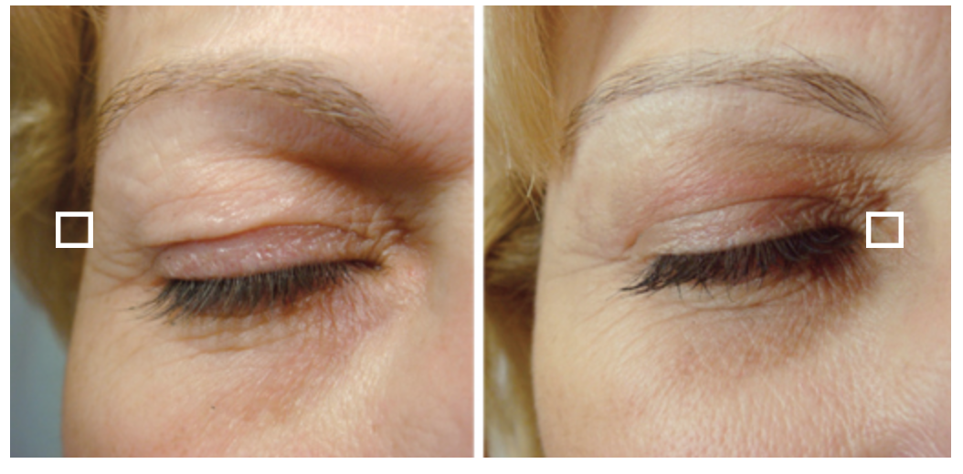

Slide 31
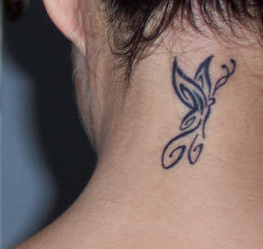
tattoo

Slide 32
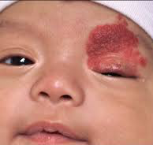
hemangioma

Slide 33
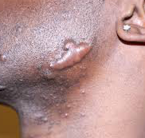
keloid

Slide 34
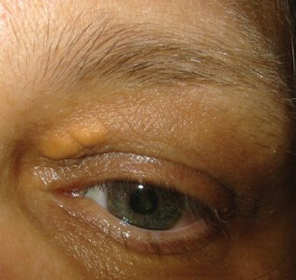
xanthlasma

Slide 35
Soft surgery
requires 1-4 treatments with an interval of at least
3-4 weeks depending on the
density and intensity
In each session sublimates around 30% of the tissue.

Slide 36
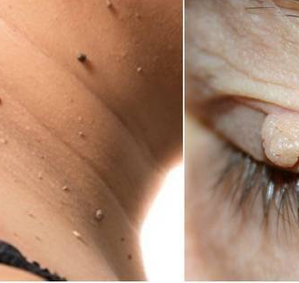
fibroma

Slide 37
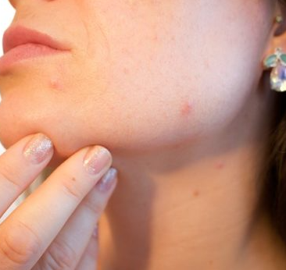
Active acne

Slide 38
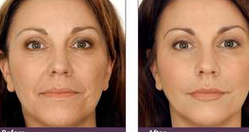

Slide 39
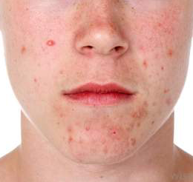
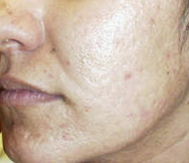
Acne treatment

Slide 40

wart

Slide 41

wart

Slide 42
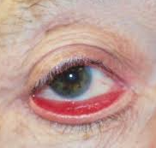
Ectropion

Slide 43
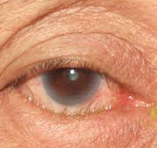
Entropion

Slide 44
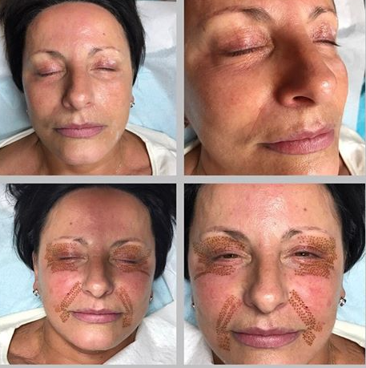
Smook sign

Slide 45
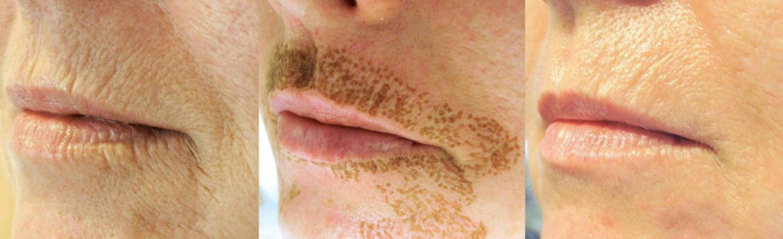
Wrinkling around mouth

Slide 46
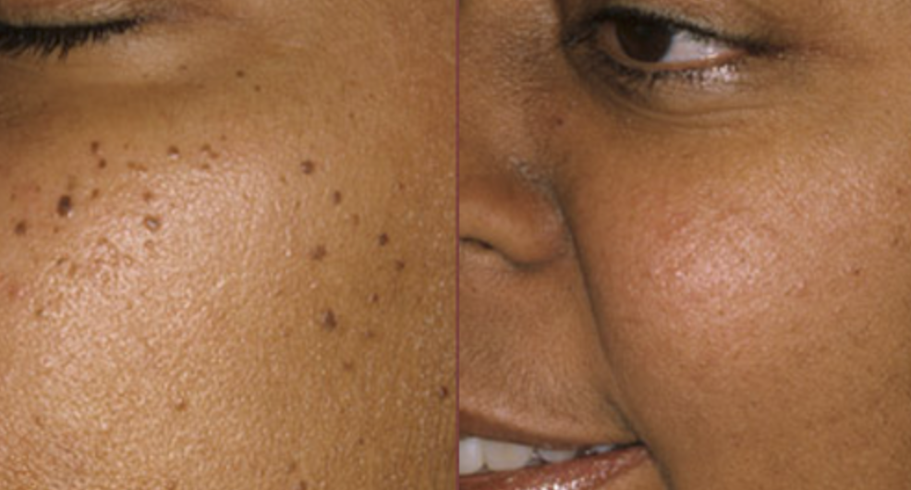
nevus

Slide 47
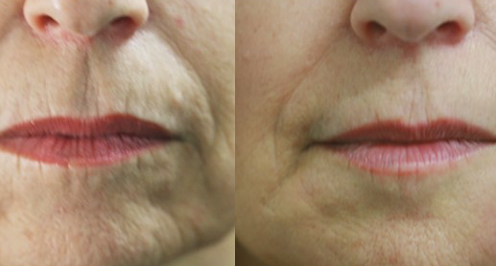

Slide 48
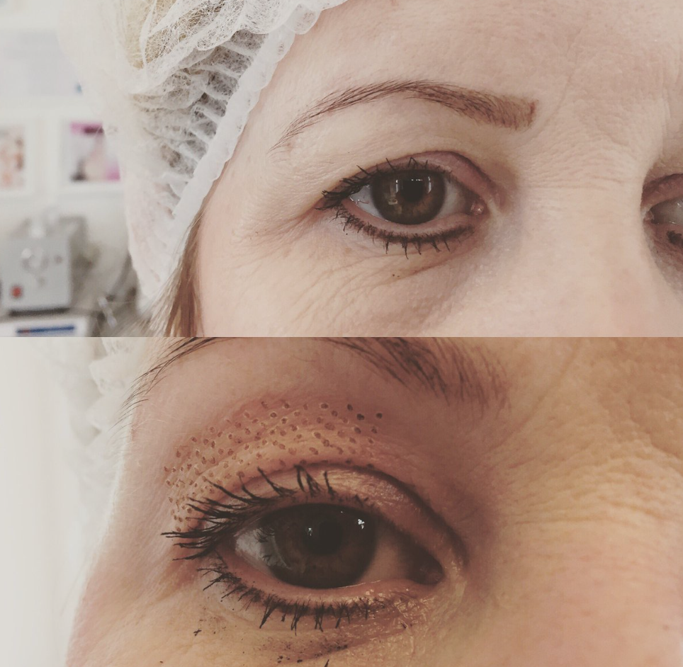
Upper eye lid lift

Slide 49
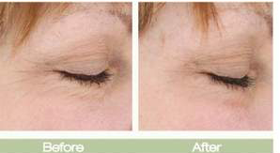
Crows feet

Slide 50
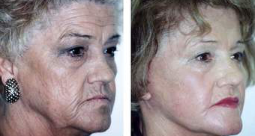
Crows feet

Slide 51
When Effect of plexr appears
Effect of plexr appears instantly
3 treatment at 6 wks interval needed to give result like surgery
best appearance seen 3-6 wks latter

Slide 52
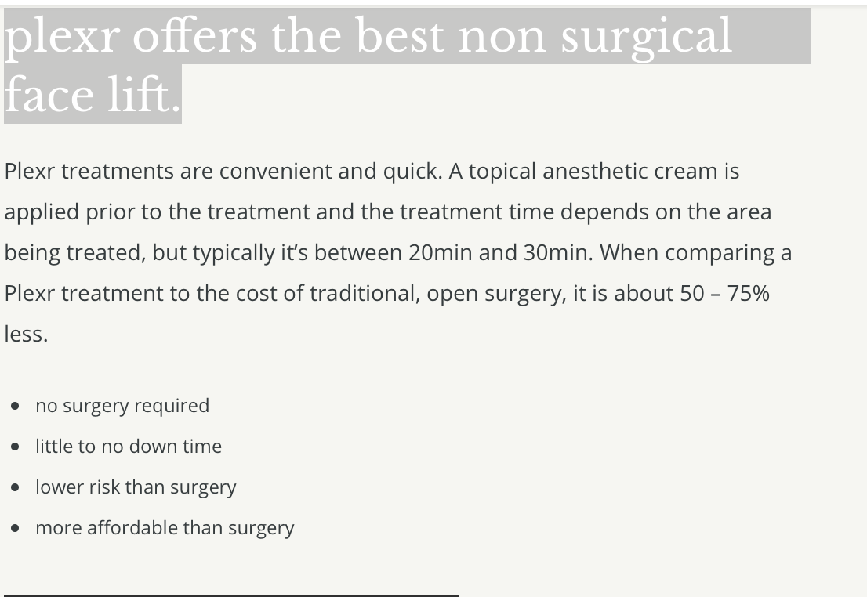

Slide 53
Plexr aplication
The heat does not spread to surronding tissue in plexr Rx
Probe does not touch skin directly 1-2 mm above the skin and 0.5 mm space in between

Slide 54
Amount of plasma production
Depends to
1-kind of probe used
Air exchange in the area of Rx(ionisation area)

Slide 55
types of treatment
Two types of treatment used by plexr
1-Spraying for pigmentation
2-spot for shortening of skin

Slide 56
Soft surgery
Is a new innovative way of tightening loose skin
It is an alternative to surgery
It may need 3 -4 session of treatment to achive the goal gradually ( 6-8 wks apart)
Perfect for people who wants gradual correction without scar

Slide 57
blepharoplasty
This instrument used for mild to moderate loose skin
It may need 3-4 session of treatment
Each treatment should be 6-8 wks apart
Sever loose skin needs surgery

Slide 58
Before operation
Clean skin with special cream for one hr
Disinfect the area before plexr Rx
Most patient feel some pain and heat at the end of Rx
There will be some black or brown area following Rx
Some inflammation may follow Rx which may need anti-inflammatory tablets it last 48-72 hr
Carbone crust may take 4-10 days to disappear so do not rub or rub area it may cause hypo or hyper pigmentation

Slide 59
Compatable treatments
Toxins can enhance the effect of plexr by relaxing contraction
Dermal filler can help to fill area and disappear wrinkles

Slide 60
Temporary side effects
Swelling for 24-72 hrs post Rx
Carbone crust(gray , brown ) scales generally last 1 wk

Slide 61
contraindication
Pregnancy
Very dark skin may give hypopigmentation or hyperpigmentation specially if crusts are picked or scrached
Malignancy
Immune deficcency
Infection in skin or systemic

Slide 62
How does plexr Rx work
1-It causes sublimation (turns solid to gas)
2-Result is instant
3- No heat transferred to surronding tissues to cause damage to normal skin
4-Rx causes tissue retraction and tightening gives better result

Slide 63
Is plexr safe & does it hurt ?
Local anesthetic cream applied 30 min before blepharoplasty to minimise any discomfort
Patient may feel hot in places and there may be a tingling or burning sensation afterwards
Post op darkening of skin rarely reported

Slide 64
Any Side effect with plexr ?
Dark brown or black spot
Appearance of burn like spots
Swelling around eye lasting several days
Area could be often red and warm immediately following procedure could be tender for few days
Sensation of tingling or burning
Crusting or a scab can develop keep it clean dry ,and protect it from sun light and other sources of UV to prevent pigmentation

Slide 65
WHAT EXPECT AFTER PLEXR Rx
Final result depends to
Severity of skin laxity
Size of leision
Desired result
general condition of skin
Pre existing skin or medical problem
Allow scab or crust to fall off naturally othere wise scarring or infection may occure (may last years to disappear)

Slide 66
Prevent complication following plexr
Keep Rx area clean, dry
Protct from sun exposure
Avoid exposure to extrem cold or heat untill heals

Slide 67
Aftercare advice
Burning following Rx responds to anti-inflammatory drugs eg ibubrufen
Swelling around eye is common even may disturb vision last several day (use anti-inflammatory or anti-histamine )
Crusting appear often initially is brown or black flake off in few days
May take 2 wks to disappear

